Slide 1
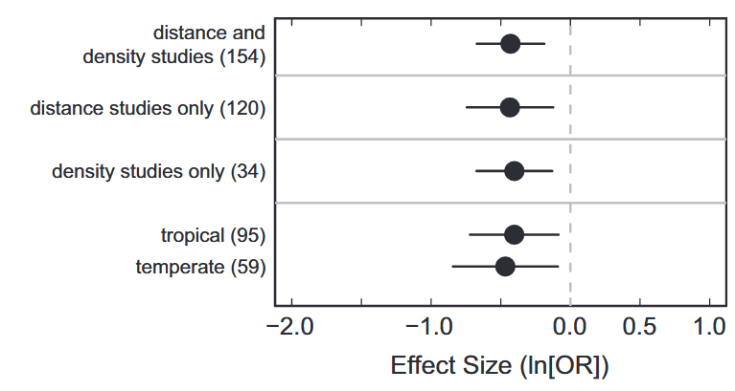
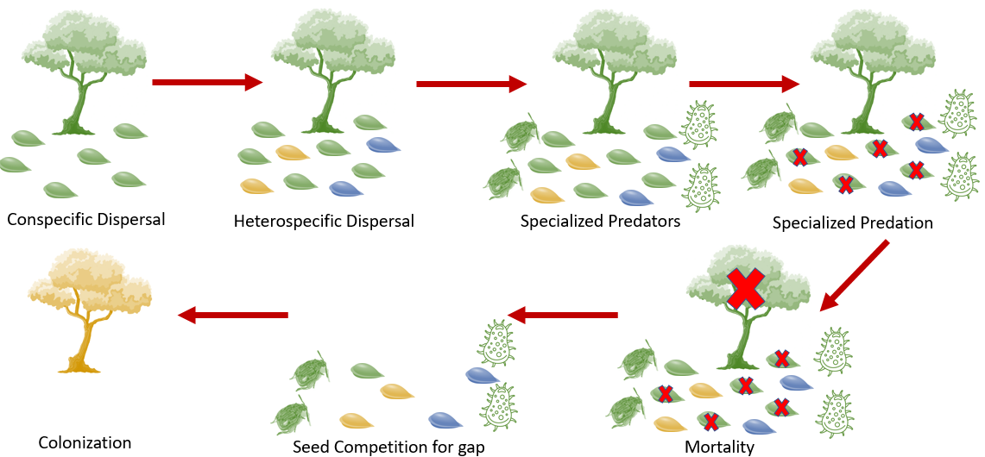
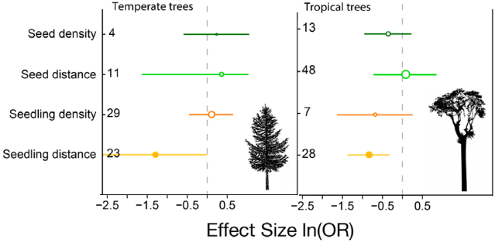
B
Comita et al. (2014)
A
1
2
3
4
(Magnitude of CNDD effects)
7
6
5
C
Song et al. (2020)
(Magnitude of CNDD effects)
Notes:
The relatively high mortality our focal green species experienced makes it less likely than the other species to colonize the patch, at least relative to when this processes doesn’t occur.

